Slide 1




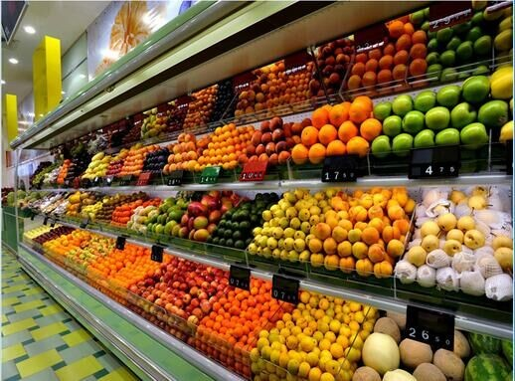
Assessing and Optimizing the Performance of
R-290 Integral Display Case

Slide 2


Introduction
The mission:
Assessing and optimizing the performance of the following R-290 integral display case.
The system comprises:
1 evaporator with 3 circuits of R290.
3 Copeland Scroll ZB09KAU-TFD compressors.
3 plate condensers.
2

Slide 3
Recommendations of the Previous Work
Revising the IMST calculations and validate the numerical results with experimental ones.
Evaluating the sources of deviation in the refrigerant charge between numerical and experimental results.
Using water as secondary fluid in the condenser gives better performance for the system compared to Ethylene Glycol.
For the same inlet conditions, Evap_Exp_V2 is much better than Evap_Exp_V1 regarding the capacity and system COP.
Reducing the condenser plates and increasing the water flow rate is considered to be a good suggestion to enhance the current system.
Proposing new compact design for the evaporator.
3

Slide 4
Objectives
To evaluate the influence of experimental errors on the final results.
To study the charge calculation and distribution in IMST-ART, regarding:
Thermal performance of each evaporator circuit.
Void fraction calculation and its validation against renowned correlations from the literature.
Different alternatives of charge distribution and retention within system components.
To evaluate new compact evaporator topologies.
4

Slide 5

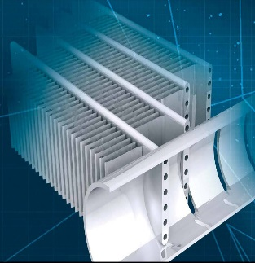

Experimental Data Analysis
Experimental Test Matrix
Product Temperature Analysis
Uncertainty Analysis of the Condenser Capacity

Slide 6
Experimental Test Matrix
All the studies are based on this test
6

Slide 7
Product Temperature Analysis
5 K
13 products are within the ISO range.
11 products are outside the higher limit (5 ºC).
Almost all the front products have temperature higher than 5 ºC.
ISO Range (-1 to +5 C)
Tmax (1.1 B)=1.8 ºC
Tmax (1.3 B)=1.8 ºC
Tmax (1.4 B)=2.8 ºC
Tmax (1.5 F)=4.4 ºC
Tmax (1.2 F)=4.4 ºC
Tmax (1.6 F)=4.9 ºC
Tmax (2.1 B)=2.8 ºC
Tmax (2.3 B)=3.5 ºC
Tmax (2.4 B)=4.4 ºC
Tmax (2.5 F)=6.1 ºC
Tmax (2.2 F)=7.5 ºC
Tmax (2.6 F)=8.7 ºC
Tmax (3.1 B)=3.2 ºC
Tmax (3.3 B)=4.1 ºC
Tmax (3.4 B)=5 ºC
Tmax (3.5 F)=7.6 ºC
Tmax (3.2 F)=9.1 ºC
Tmax (3.6 F)=10 ºC
Tmax (4.1 B)=4.7 ºC
Tmax (4.3 B)=6.6 ºC
Tmax (4.4 B)=7.7 ºC
Tmax (4.5 F)=8.9 ºC
Tmax (4.2 F)=9.8 ºC
Tmax (4.6 F)=10.4 ºC
7

Slide 8
Product Temperature Analysis
Representative Point
We think that there is an electrical interference that affects the temperature measurements.
8

Slide 9
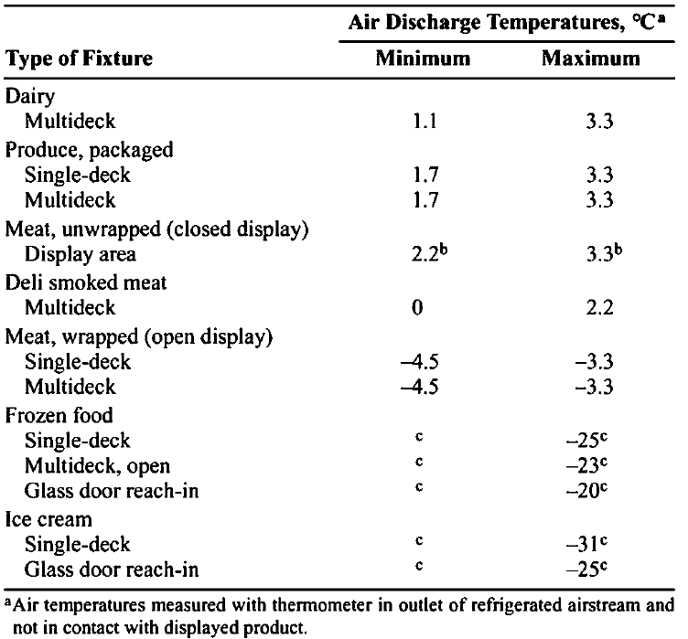
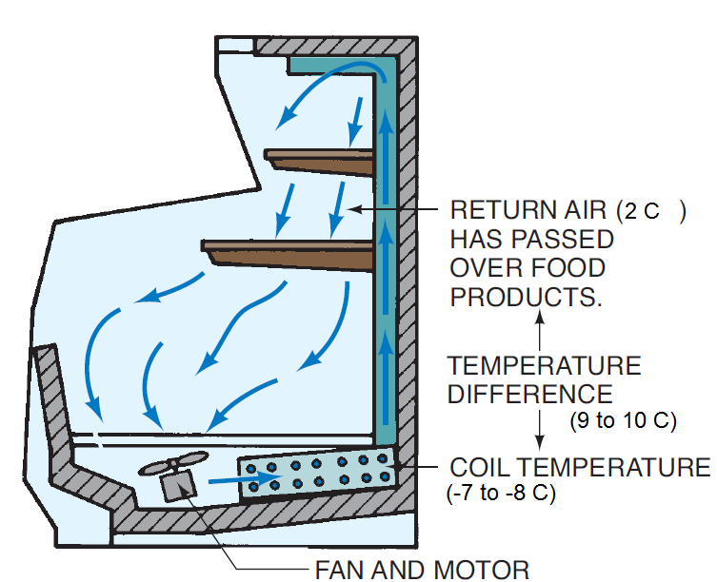
Product Temperature Analysis
Proper maintenance of product temperature relies heavily on the temperature of air discharged into the refrigerator. Next table lists discharge air temperatures in various display refrigerators (ASHRAE 2010)
9

Slide 10
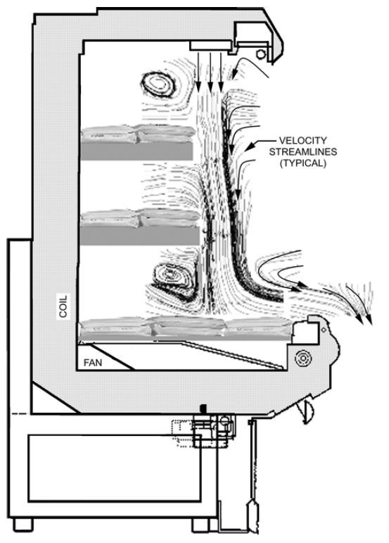
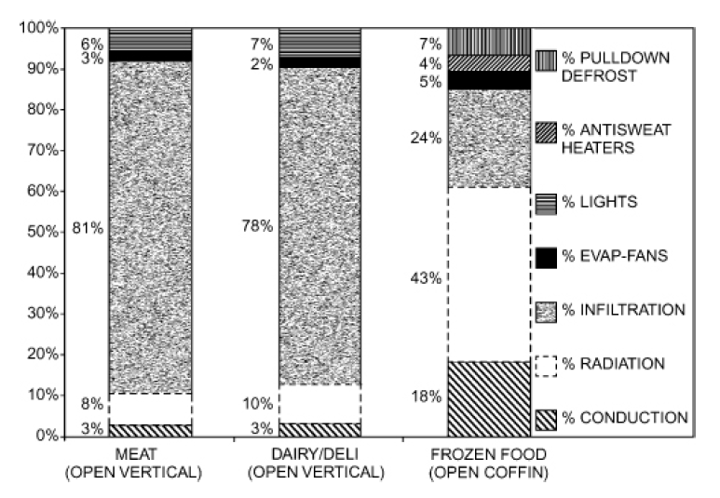
Product Temperature Analysis
Open vertical display refrigerators rely on their air curtains to keep warm ambient air from penetrating into the cold environment inside the refrigerator.
major contributor to the total cooling load of open display refrigerators are infiltration and radiation.
Infiltration constitutes approximately 80% of the cooling load of a typical medium-temperature open vertical display refrigerator (ASHRAE 2010).
10

Slide 11
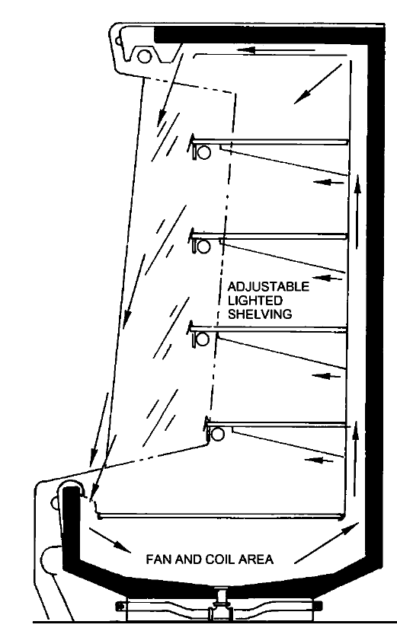
Product Temperature Analysis
Based on the previous analysis, we think that the air curtains do not work properly.
This, in turn, results to high product temperature due to high infiltration rate.
The total performance of the air curtain and the amount of heat transferred across it may depend on several factors (ASHRAE 2010), including:
Air curtain velocity and temperature profile.
Number of jets.
Air jet width and thickness.
Dimensional characteristics of the discharge air honeycomb.
Store and display refrigerator temperatures and humidity ratios.
Rate of air curtain agitation caused by shoppers passing.
11

Slide 12
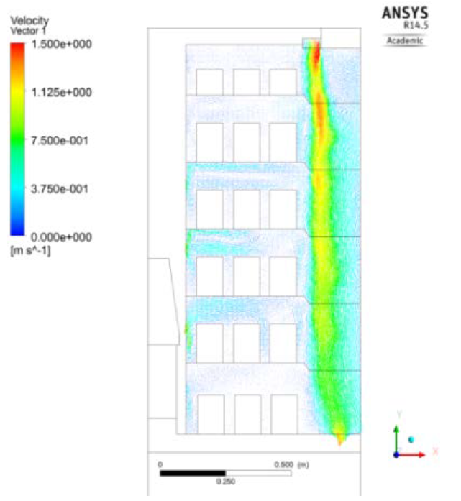
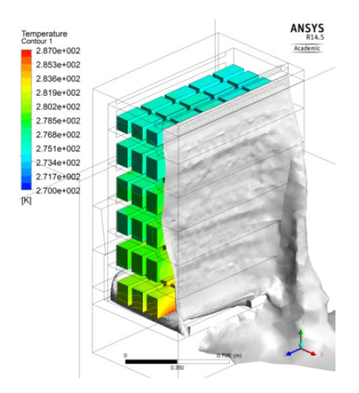
Product Temperature Analysis
Sun et al. (2017) used CFD modelling to investigate the influence of air guiding strips on the performance of vertical multi-deck display cabinets.
1.2 m
2 m
0.8 m
Air velocity at the middle plane of the conventional cabinet and 3D air curtain.
12

Slide 13
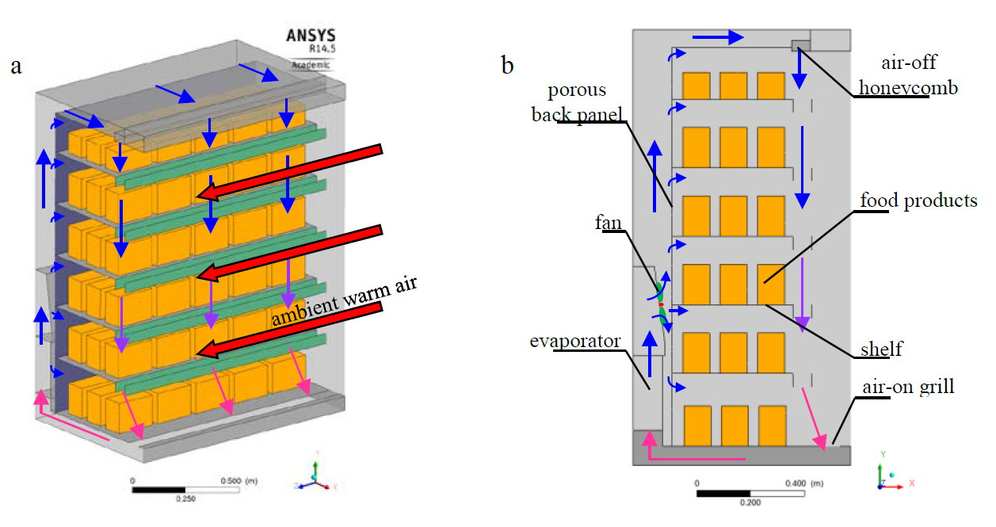
Product Temperature Analysis
air guiding strips with height of 50 mm, and air gab of 70 mm
They concluded that using air guiding strips results to:
The average food temperature decreased by 4.9 ºC.
The cooling capacity decreased by 34%.
The air guiding strips accelerate the cool air at their gap centers and restrict the air flow vertical, causing a stronger air curtain which is impacted less by the ambient warm air cross flow.
13

Slide 14
Error Propagation in Condenser Capacity
water-side condenser capacity affects:
Quality at the outlet of condenser
Enthalpy at the inlet of evaporator
Total system charge
Assuming an uncertainty on the temperature of 0.1K and of 1% in the determination of the mass flow (optimistic)
 | Exp. Data (Test 24) | Uncertainty
h_cond_out (kJ/kg) | 325.06 | ±9.9 kJ/kg
x_cond_out | 0.10 | ±0.03
Qcond (kW) | 9.46 | ±0.27 kW
x_evap_in | 0.35 | ±0.026
Qevap (kW) | 6.95 | ±0.27 kW
14

Slide 15
Charge analysis
Thermal Performance of Evaporator Circuits
Void Fraction Analysis and Validation
Charge Estimation and Distribution

Slide 16
Thermal Performance of Evaporator Circuits
Evaporator Coil Temperatures (Test 24)
IMST results showed that none of the circuits are totally superheated.
The superheat condition exists only at the last tube for the three circuits.
Maximum deviation of 2 ºC has been encountered, compared with experimental data.
16
Notes:
YO PONDRIA ESTA PRIMERO.

Slide 17
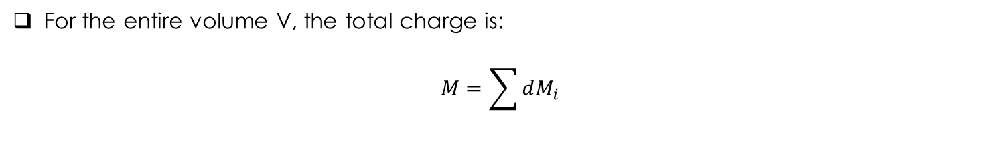
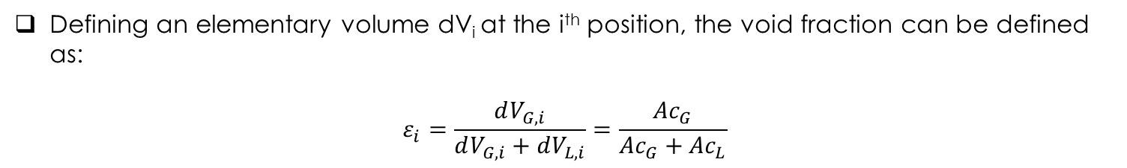
Void Fraction Analysis and Validation
To determine the refrigerant charge in evaporators and condensers, it is necessary to know the proportion of vapor and that of liquid present at any location of the heat exchanger.
This proportion is called Void Fraction (ε).
Defining an elementary volume dV_{i} at the i^{th} position, the void fraction can be defined as:
$$ε_{i}=\frac{dV_{G,i}}{dV_{G,i}+dV_{L,i}}=\frac{{Ac}_{G}}{{Ac}_{G}+{Ac}_{L}}$$
Ac_{G}
Ac_{L}
Cross-section of a tube=Ac_{G}+Ac_{L}
Then, the elementary mass dM_{i} contained in the volume dV_{i} is given by:
$$dM_{i}=\left[ε_{i}ρ_{G,i}+\left(1−ε_{i}\right)ρ_{L,i}\right]dV_{i}$$
Two-phase Flow density
For the entire volume V, the total charge is:
$$M=\sum{dM_{i}}$$
17

Slide 18
Void Fraction Analysis and Validation
Based on extensive reviews and experimental analyses done by many authors in the literature, such as; Rice (1987), Thome (2006), Poggi et al. (2008), and Spencer (2013), the following are the most renowned and cited correlations used to predict the void fraction:
Chisholm (1967): empirical correlation based on vapor quality and refrigerant properties, it does not depend on mass flux.
Steiner (1993): mass flux dependent correlation based on the drift flux model.
Tandon et al. (1985): mass flux dependent correlation based on Lockhart and Martinelli parameter.
Premoli et al. (1970): mass flux dependent model based on annular Flow assumption.
Hughmark (1962): It depends on vapor quality, density and viscosity of each phase, mass flux and tube geometry.
18

Slide 19
Void Fraction Analysis and Validation
19

Slide 20
Void Fraction Analysis and Validation
Based on these results, we have decided to use Chisholm correlation because it represents a central value between the tested correlations (-37 g from Hughmark, and +20 g from Steiner).
Besides, it is more simple and gives consistent results.
20

Slide 21

Void Fraction Analysis and Validation
Based on the previous analysis, we have validated the numerical results of void fraction (based on Chisholm correlation) with Engineering Data Book III calculator (Thome 2006).
This calculator is a sophisticated excel file which used to evaluate heat transfer coefficient, Flow patterns, frictional pressure drop coefficient, and void fraction for refrigerants based on the most renowned correlations exist in literature.
21

Slide 22
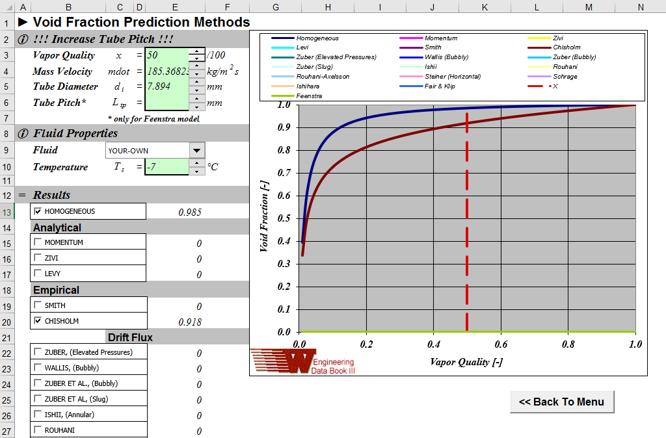
Void Fraction Analysis and Validation
22

Slide 23
Void Fraction Analysis and Validation
23

Slide 24
Preliminary Charge Estimation
Actual Charge=450 g
IMST Analysis
Component | Charge (g)
Evaporator | 148.5
Condensers | 40.4
Liquid lines | 12.5
Dissolved Ref. in oil | 62.4
Total | 263.8
Deviation from actual charge | -186.2
100% of the oil volume is inside the compressor.
The estimated oil temperature is 30 ºC.
Tevap= -7.6 ºC.
The solubility is only 5%.
We are missing 40% of the charge
24

Slide 25
Preliminary Charge Estimation
Actual Charge=450 g
Max. Charge Analysis
Component | Charge (g)
Evaporator | 238
Condensers | 134
Liquid Lines | 12.5
Dissolved Ref. in oil | 62.4
Total | 446.9
Deviation from actual charge | -3.1
Assuming all the refrigerant has the same inlet density
Assuming all the refrigerant has the same outlet density
Assuming 100% of oil volume is inside compressors
Yes we have reached the actual charge! But this situation is infeasible
25

Slide 26
Preliminary Charge Estimation
Actual Charge=450 g
Max. Charge Analysis
Component | Charge (g)
Evaporator | 238
Condensers | 134
Liquid Lines | 12.5
100% of oil in Evaporator (Tevap=Toil= -7.6 ºC; Solubility= 35%)
Dissolved Ref. in oil | 375 g
Total system charge | 759.5 g
Deviation from actual charge | +309.5 g
100% of oil in Condenser (Tcond=Toil= 35.5 ºC; Solubility= 37%)
Dissolved Ref. in oil | 367.5 g
Total system charge | 752 g
Deviation from actual charge | +302 g
This analysis implies that when the oil migrates to condenser or evaporator (oil retention), the solubility of refrigerant significantly increases, and the oil is capable of absorb a large amount of charge.
26

Slide 27
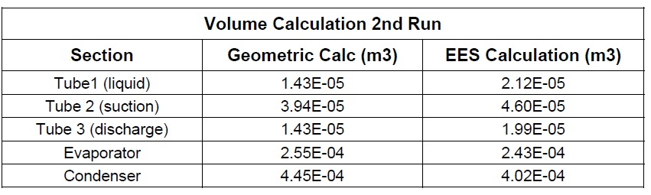
Oil Retention: A Literature Review
Sheth and Newell (2005) conducted an experimental campaign to collect quantitative oil hold up data for a commercially available air conditioning system using R-22 as the refrigerant.
The air conditioning unit used for this experiment is a Sunbeam model SCK 5200M air conditioner with a cooling capacity of 1524 W (5200 BTU/hour).
The quantity of R-22 refrigerant in the system is 404 g. The design pressures for the unit are 2.55 Mpa on the high end and 1.03 Mpa on the low end.
The current evaporator volume=3.13 L (larger by 2.9 L)
The current condensers volume=0.58 L (larger by 0.135 L)
=0.255 L
=0.445 L
27

Slide 28
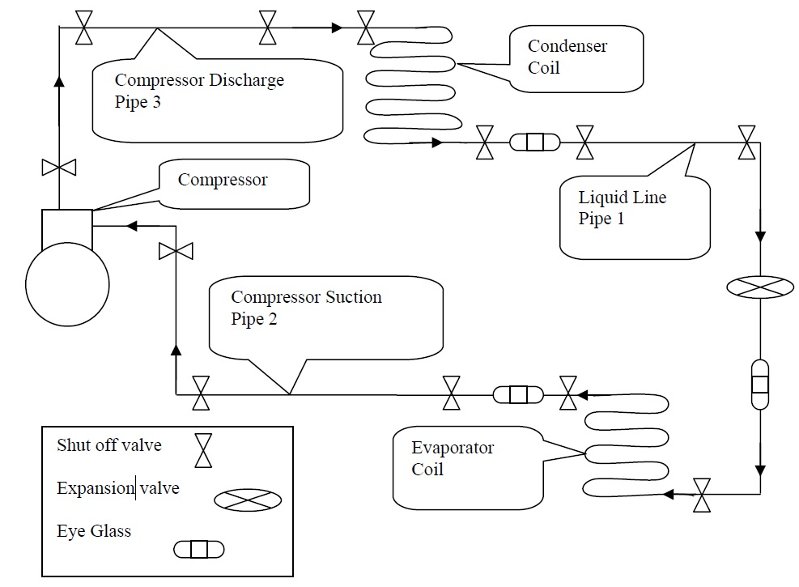
Oil Retention: A Literature Review
After 2 hrs
The system was turned on and then allowed to stabilize for approximately 2 hours. After this the power to the compressor was cut off while all the shut off valves were simultaneously turned off to trap the refrigerant and oil in the respective components.
The components was then disconnected from the system and weighed. In order to evaluate the mass of refrigerant and oil trapped in each one.
28

Slide 29
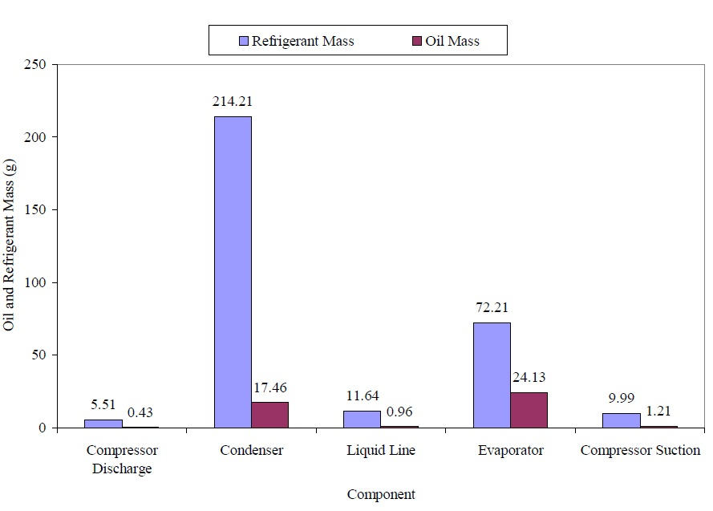
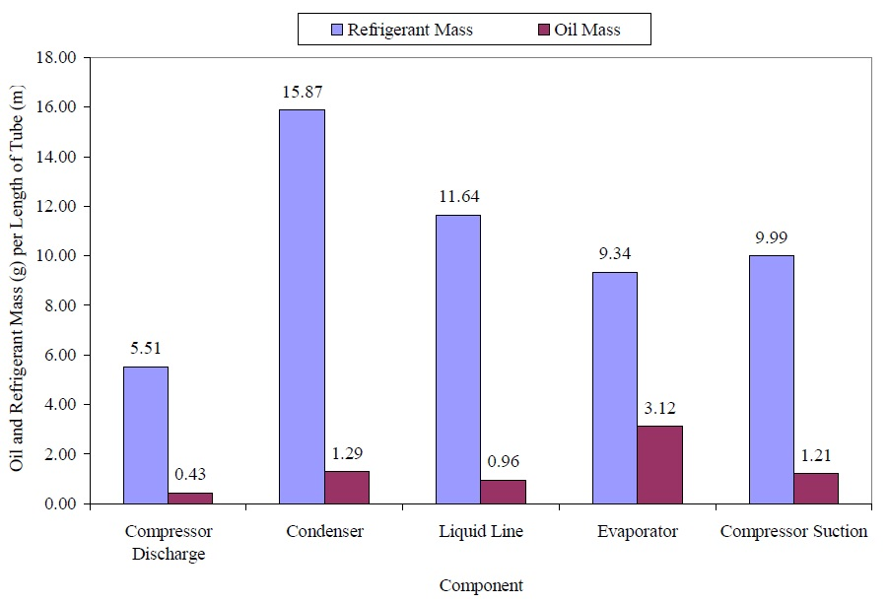
Oil Retention: A Literature Review
They concluded that the condenser and evaporator have the largest amount of oil and refrigerant out of all the components due to their size.
Tevap=13 C
Tcond=27 C
Tevap=13 C
Tcond=27 C
Higher by 38%, compared to condenser
Higher by 142%, compared to condenser
They also tried to estimate the oil mass in system components using EES program, however the numerical results showed large deviations compared to experimental ones.
This indicates the difficulty to estimate accurately the oil retention in different components, especially evaporators and condensers.
29

Slide 30
Oil Retention: A Literature Review
Cremaschi et al. (2005) measured the oil retention characteristics in A/C systems using R22, R410A, and R134a with miscible and non-miscible lubricants.
Their test unit is designed for R22 and is rated 10 kW. The evaporator has five parallel passes, while the condenser has four parallel passes. A modified scroll compressor with a sight tube and a sight glass was used.
They concluded that the oil retention volume ratio was up to 30% based on the total volume initially charged in the compressor.
The suction line is the most critical component for oil retention due to highest liquid film viscosity and low inertia force from the vapor refrigerant core, which is the driving force for oil transport.
The gravity effects are important and the oil retention can increase up to 50% more in the vertical upward suction line compared to horizontal suction line at the same refrigerant mass flux and liquid film viscosity.
30

Slide 31
Oil Retention: A Literature Review
Jin and Hrnjak (2013) presented experimental results for refrigerant and lubricant mass distribution in a typical automotive A/C (MAC) system.
Experiments were conducted by closing valves located at the inlet and outlet of each component after reaching steady state, isolating the refrigerant and lubricant in each component.
R134a and R1234yf were used with PAG 46 oil as working fluid at different Oil Circulation Ratio (OCR), ranging from 2% to 4%. Experiments were conducted in two standard testing conditions: I35 and L35 (SAE Standard J2765).
Their results showed that in a typical MAC system, only less than 25% of the total lubricant charge is retained in the compressor at a steady state operating condition.
31

Slide 32
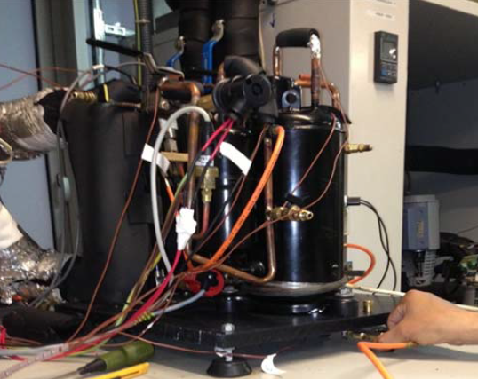
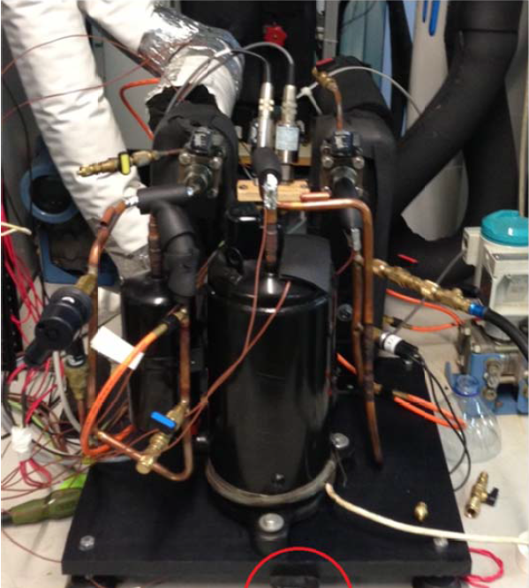
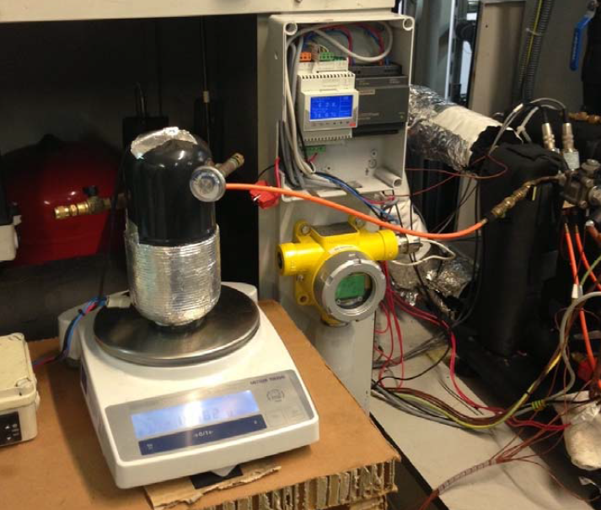
Oil Retention: A Literature Review
Previously, our group implemented some experimental campaigns to estimate the refrigerant charge in heat pumps using propane as refrigerant.
32

Slide 33
Oil Retention: A Literature Review
The IMST-ART noticeably underpredicted the evaporator charge, unlike the condenser charge, as shown in figures below.
This could give us an indication that the oil retention inside evaporator has an influential impact on the total charge estimation.
As it has been discussed before, it is very difficult to capture this phenomenon by numerical models. Furthermore, it needs sophisticated experimental techniques, beside much time, in order to estimate accurately the amount of oil inside each system component.
33

Slide 34
Charge Estimation and Distribution
Based on the previous analysis and discussion, we have assumed that 60% of oil is inside the evaporator, while the rest is inside the compressors.
This assumption allows us to obtain the accurate amount of the total charge, as shown below.
IMST Analysis
Element |  | Charge (g)
Evaporator |  | 148.5
Condensers |  | 40.4
Liquid Lines |  | 12.5
Dissolved Ref. in oil | 40% of oil in comp. | 25
 | 60% of oil in evap. | 225
Total |  | 451.4
Deviation from actual charge |  | 1.4
Based on the evaporator volume, this amount of oil results to a layer of 0.6 mm inside the evaporator tubes as seen in this figure.
Oil layer of 0.6 mm
Evaporator Tube: ID=7.894 mm and L=3.4 m
34

Slide 35
Summary
The uncertainty analysis showed that small errors in measurements could lead to significant deviation in outlet quality from condenser. This, in turn, could affect the estimation of system charge.
The IMST results show that the three circuits of the evaporators work properly.
IMST correctly estimated the void fraction values compared with renowned correlations existed in the literature.
Based on extensive literature review and previous results of our group, the oil retention in the evaporator must be considered in order to estimate properly the total charge.
However, This issue does not affect the reliability of the software regarding the overall performance.
35

Slide 36
References
ASHRAE, 2010. ASHRAE Handbook: Refrigeration (SI edition), Atlanta, GA.
Chisholm, D., 1967. A theoretical basis for the Lockhart-Martinelli correlation for two-phase flow. International Journal of Heat and Mass Transfer, 10, pp. 1767–1778.
Cremaschi, L., Hwang, Y., Radermacher, R., 2005. Experimental investigation of oil retention in air conditioning systems. International Journal of Refrigeration, 28(7), pp. 1018–1028.
Hughmark, G.A., 1962. Holdup in gas–liquid flow. Chemical Engineering Progress, 58 (4), pp. 62–65.
Jin, S., Hrnjak, P., 2013. Refrigerant and lubricant distribution in MAC system. SAE International Journal of Passenger Cars - Mechanical Systems, 6(2), pp. 1013- 1020.
Poggi, F., Macchi-Tejeda, H., Leducq, D., Bontemps, A., 2008. Refrigerant charge in refrigerating systems and strategies of charge reduction. International Journal of Refrigeration, 31(3), pp. 353–370.
Premoli, A., Di Francesco, D., Prina, A., 1970. Una correlazione adimensionale per la determinazione delle densità di micele bifasiche. Une corrèlation adimensionnelle pour la dètermination de la densitèd’un mèlange diphasique. In: XXV Congresso Nazionale ATI, Triete, Italie, septembre.
Rice, C.K., 1987. The effect of the void fraction correlation and heat flux assumption on refrigerant charge inventory predictions. In: American Society of Refrigerating and Air Conditioning Engineers Meeting, New York, pp. 341–357.
36

Slide 37
References
Sheth, V.P., Newell, T.A., 2005. Refrigerant and oil migration and retention in air conditioning and refrigeration systems. ACRC TR-240, Air Conditioning and Refrigeration Center, University of Illinois at Urbana-Champaign IL.
Spencer, J.D., 2013. An investigation of void fraction for low GWP refrigerants. MSc. thesis, University of Maryland, College Park.
Steiner, D., 1993. Heat transfer to boiling saturated liquids, in VDI-Warmeatles (VDI Heat Atlas), Dusseldorf, Germany, VDI-Gesellschaft Verfahrenstechnik und Chemieingenieurwesen.
Sun, J., Tsamos, K.M. and Tassou, S.A., 2017. CFD comparisons of open-type refrigerated display cabinets with/without air guiding strips. Energy Procedia, 123, pp.54-61.
Tandon, T.N., Varna, H.K., Gupta, C.P., 1985. Void fraction model for annular two-phase flow. International Journal of Heat and Mass Transfer, 28 (1), pp. 191–198.
Thome, J., 2006. Wolverine Heat Transfer Engineering Data book III. [Online]. Available: http://www.wlv.com/products/databook/db3/DataBookIII.pdf
37

Slide 38
New Evaporator Topologies

Slide 39
Input Conditions (Test 24)
The inlet conditions used in the IMST numerical analysis, in the current section, are the conditions of Test 24.
Inlet Conditions (Test 24)
T_water_in (ºC ) | 30
T_water_out (ºC ) | 35.3
SH (K) | 8.2
T_air_in (ºC) | 8.5
V_air_in (m³/h) | 1811.7
Charge (Evap. + Cond. only) (g) | 181.8
39

Slide 40
9.5 mm Tubes+3 Circuits Staggered Evap.
In order to obtain better performance of the evaporator we have proposed the following staggered compact design:
Fin
100 mm
OD=9.52 mm
ID=7.894 mm
TS=20 mm
LS=25 mm
125 mm
Also we have kept the same fin pitch 5 mm, fin thickness 0.08 mm, and HX width 3.4 m.
40

Slide 41
9.5 mm Tubes+3 Circuits Staggered Evap.
The following table shows the comparison between the current new evaporator (Evap_Num_5x4_ST_3c_V2) and Evap_Exp_V2.
Comparison between Evaporators (Test 24) (Numerical Results)
 | Evap_Num_5x4_ST_3c_V2 (IMST_008) | Evap_Exp_V2 (IMST_003) | Difference
Capacity (kW) | 8.14 | 6.94 | 1.2 kW
Tevap (ºC) | -3.8 | -7.6 | 3.8 ºC
T_air_out (ºC) | -0.05 | 1.33 | -1.4 ºC
∆p_air (Evap. Only)(Pa) | 27 | 34 | -7 Pa
COP_AUX | 3.3 | 2.73 | 21%
41

Slide 42
9.5 mm Tubes+3 Circuits Staggered Evap.
Comparison of geometries between the two evaporators is summarized next
Comparison of Geometries between (Evap_Num_5x4) and (Evap_Exp_V2)
 | Evap_Num_5x4_ST_3c_V2 | Evap_Exp_V2 | Diff
Tube diameter (mm) | 9.52 | 9.52 | -
Number of rows | 5 | 16 | -11
Number of circuits | 3 | 3 | -
Core height (mm) | 100 | 100 | -
Core depth (mm) | 125 | 400 | -275 mm
Finned length (mm) | 3400 | 3400 | -
Fin surface area (m²) | 13.6 | 13.6 | -
Total coil surface area (m²) | 15.4 | 15.4 | -
Compactness ratio (m2/m3) | 362.1 | 113.15 | 220%
Total Fluid Volume (L) | 3.04 | 3.13 | -0.1 L
Total Mass Inventory (g) | 150.3 | 155.3 | -5 g
42

Slide 43
9.5 mm Tubes+3 Circuits Inline Evap.
The same previous evaporator is used, but the tubes are in inline configuration:
5x4_InLin_3c_V2
Fin
100 mm
Air
OD=9.52 mm
ID=7.894 mm
TS=20 mm
LS=25 mm
125 mm
Also we have kept the same fin pitch 5 mm, fin thickness 0.08 mm, and HX width 3.4 m.
43

Slide 44
9.5 mm Tubes+3 Circuits Inline Evap.
The following table shows the comparison between the current new evaporator (Evap_Num_5x4_InLin_3c_V2) and Evap_Exp_V2.
Comparison between Evaporators (Test 24) (Numerical Results)
 | Evap_Num_5x4_InLin_3c_V2 (IMST_026) | Evap_Exp_V2 (IMST_003) | Difference
Capacity (kW) | 8.14 | 6.94 | 1.2 kW
Tevap (ºC) | -4 | -7.6 | 3.6 ºC
T_air_out (ºC) | -0.124 | 1.33 | -1.454 ºC
∆p_air (Evap. Only) (Pa) | 27 | 34 | -7 Pa
COP_AUX | 3.3 | 2.73 | 21%
44

Slide 45
7.9 mm Tubes+9 Circuits Staggered Evap.
In order to obtain better performance of the evaporator, we have proposed new configuration which comprises: 7.9 mm tubes + 9-circuits + Distributor :
Fin
5x4_ST_9c_V4
100 mm
Air
OD=7.92 mm
ID=6.294 mm
TS=20 mm
LS=25 mm
125 mm
Also we have kept the same fin pitch 5 mm, fin thickness 0.08 mm, and HX width 3.4 m.
45

Slide 46
7.9 mm Tubes+9 Circuits Staggered Evap.
The following table shows the comparison between the current new evaporator (Evap_Num_5x4_ST_9c_V4) and Evap_Exp_V2.
Comparison between Evaporators (Test 24) (Numerical Results)
 | Evap_Num_5x4_ST_9c_V4 (IMST_020) | Evap_Exp_V2 (IMST_003) | Difference
Capacity (kW) | 9.15 | 6.94 | 2.21 kW
Tevap (ºC) | -4.8 | -7.6 | 2.8 ºC
∆p_ref (kPa) | 9.1 | 51.8 | -42.7 kPa
T_air_out (ºC) | -1.1 | 1.33 | -2.43 ºC
∆p_air (Evap. Only) (Pa) | 16.6 | 34 | -17.4 Pa
COP_AUX | 3.6 | 2.73 | 32%
46

Slide 47
7.9 mm Tubes+9 Circuits Staggered Evap.
Comparison of geometries between the two evaporators is summarized next
Comparison of Geometries between (Evap_Num_5x4_ST_9c_V4) and (Evap_Exp_V2)
 | Evap_Num_5x4_ST_9c_V4 | Evap_Exp_V2 | Diff
Tube diameter (mm) | 7.92 | 9.52 | -1.6 mm
Number of rows | 5 | 16 | -
Number of circuits | 9 | 3 | -
Core height (mm) | 100 | 100 | -
Core depth (mm) | 125 | 400 | -275 mm
Finned length (mm) | 3400 | 3400 | -
Fin surface area (m²) | 14.1 | 13.6 | 0.5 m²
Total coil surface area (m²) | 15.6 | 15.4 | 0.2 m²
Compactness ratio (m2/m3) | 367.45 | 113.15 | 225 %
Total Fluid Volume (L) | 1.92 | 3.13 | -1.21 L
Total Mass Inventory (g) | 63.5 | 155.3 | -91.8 g
47

Slide 48
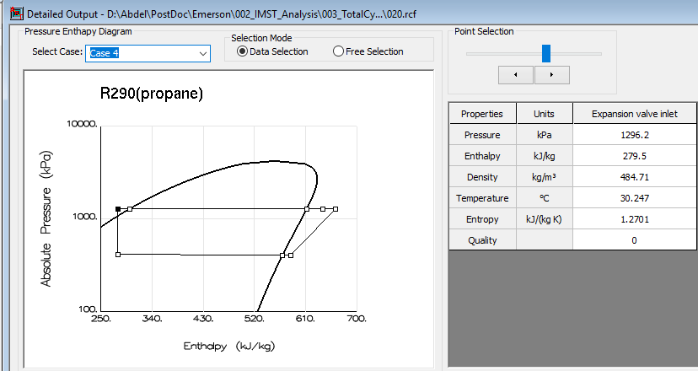
7.9 mm Tubes+9 Circuits Staggered Evap.
Furthermore, it is expected that the modified system has a 7.4 K of subcooling, as shown in the next figure.
Also, the refrigerant-side pressured drop in the new evaporator significantly decreased by 43 kPa, compared to the Evap_Exp_V2.
48

Slide 49
7.9 mm Tubes+9 Circuits Inline Evap.
The same previous evaporator is used but the tubes are in inline configuration:
5x4_InLin_9c_V4
Fin
100 mm
Air
OD=7.92 mm
ID=6.294 mm
TS=20 mm
LS=25 mm
125 mm
Also we have kept the same fin pitch 5 mm, fin thickness 0.08 mm, and HX width 3.4 m.
49

Slide 50
7.9 mm Tubes+9 Circuits Inline Evap.
The following table shows the comparison between the current new evaporator (Evap_Num_5x4_InLin_9c_V4) and Evap_Exp_V2.
Comparison between Evaporators (Test 24) (Numerical Results)
 | Evap_Num_5x4_InLin_9c_V4 (IMST_027) | Evap_Exp_V2 (IMST_003) | Difference
Capacity (kW) | 9.1 | 6.94 | 2.16 kW
Tevap (ºC) | -5 | -7.6 | 2.6 ºC
∆p_ref (kPa) | 9.1 | 51.8 | -42.7 kPa
T_air_out (ºC) | -1 | 1.33 | -2.33 ºC
∆p_air (Evap. Only) (Pa) | 16 | 34 | -18 Pa
COP_AUX | 3.55 | 2.73 | 30%
50

Slide 51
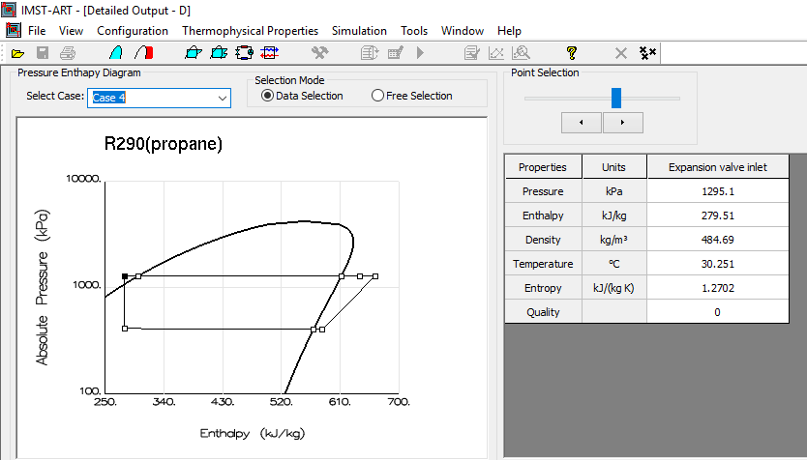
7.9 mm Tubes+9 Circuits Inline Evap.
Furthermore, it is expected that the modified system has a 7.3 K of subcooling, as shown in the next figure.
Also, the refrigerant-side pressured drop in the new evaporator significantly decreased by 43 kPa, compared to the Evap_Exp_V2.
51

Slide 52
New Evap. Provided by Emerson
This new evaporator (16x4_ST_3c_V5) has the following configuration:
Canceled Tube
52

Slide 53
New Evap. Provided by Emerson
Now, the system uses new compressor (ZB09KAU-TFD-Hyb), and new oil (3MAF).
This new oil has more solubility compared with the previous one (Hatcol 4467).
Based on the assumption of 60% of oil is inside the evaporator, the amount of oil dissolved inside the oil layer now is 239 g.
This amount is higher by 14 g, compared with old oil.
This, in turn, affects the charge inside new evaporator. The new evaporator charge now is 135 g, compared to 149 g for Evap_Exp_V2.
Next table shows the numerical comparison between current evaporator and Evap_Exp_V2.
Comparison between Evaporators (Test 24new) (Numerical Results)
 | Evap_Num_16x4_ST_3c_V5 (IMST_001) | Evap_Exp_V2 | Difference
Capacity (kW) | 7.3 | 6.94 | 0.36 kW
Charge (Evap. + Cond. Only) (g) | 168 | 182 | -14 g
Tevap (ºC) | -3.35 | -7.6 | 4.25 ºC
T_air_out (ºC) | 0.8 | 1.33 | -0.53 ºC
COP_AUX | 2.8 | 2.73 | 2.6%
53

Slide 54
New Evap. Provided by Emerson
Using the same old oil, compressor, and charge adopted by Test 24.
The comparative study between the two evaporators is summarized as follows:
Comparison between Evaporators (Test 24) (Numerical Results)
 | Evap_Num_16x4_ST_3c_V5 (IMST_029) | Evap_Exp_V2 (IMST_003) | Difference
Capacity (kW) | 7.96 | 6.94 | 1.02 kW
Charge (Evap. + Cond. Only) (g) | 182 | 182 | 0
Tevap (ºC) | -4.12 | -7.6 | 3.48
∆p_ref (kPa) | 59 | 51.8 | 7.2 kPa
T_air_out (ºC) | 0.07 | 1.33 | 1.26 ºC
∆p_air (Evap. only) (Pa) | 48 | 34 | 14 Pa
COP_AUX | 3.2 | 2.73 | 17.2%
54

Slide 55
Summary
The compact 9.5 mm, 5x4, 3c evaporator improves the total system performance compared with Evap_Exp_V2 evaporator. It resulted to an increase in cooling capacity, evaporation temperature, and COP by 1.2 kW, 3.8 ºC, and 21%, respectively.
Further improvement of system performance could be achieved by reducing the evaporator’s tubes diameter and increasing the number of circuits. The proposed compact 7.9 mm, 5x4, 9c evaporator has shorter core depth (along air-side direction) by 275 mm, higher compactness ratio by 225%, and lower internal volume by 1.21 L, compared to Evap_Exp_V2 evaporator.
The proposed evaporator resulted to an increase in cooling capacity, evaporation temperatura, and COP by 2.21 kW, 2.8 ºC, and 32%, respectively, compared to Evap_Exp_V2 evaporator.
55

Slide 56
Summary
Moreover, it is expected that the modified system will have a 7.3 K subcooling, for the same total charge used in Test 24. Also, the refrigerant-side pressure drop in the proposed evaporator significantly decreased by 43 kPa compared to Evap_Exp_V2 evaporator.
Regarding the new evaporator (Evap_Num_16x4_ST_3c_V5) and system modifications proposed by Emerson, the new oil (3MAF) has higher solubility compared to the old one (Hatcol 4467). This, in turn, affects the charge inside the new evaporator. The new evaporator charge now is 135 g, compared to 149 g for Evap_Exp_V2.
However, for the same operating conditions, oil, compressor, and charge adopted by Test 24 and Evap_Exp_V2 evaporator. The new evaporator proposed by Emerson resulted to higher capacity by 1.02 kW, higher evaporation temperature by 3.48 ºC, and higher COP by 17.2% compared to Evap_Exp_V2 evaporator. These results are quite similar to the compact 9.5 mm, 5x4, 3c evaporator results.
56

Slide 57
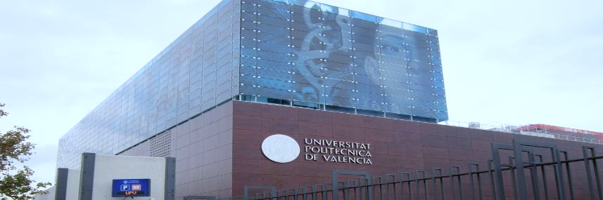


Thanks for Your Attention

